Slide 1
The six point movement

Slide 2
Title and Content Layout with List
Why Six Point was declared?
The Six Point
Reactions
Impact of the movement

Slide 3
Why six point was declared?
Political Perspective
Administrative and Economic Perspective
Military Perspective

Slide 4
Political perspective
Violation of Lahore Resolution in both conditions-autonomy and separate states
Intentional delay in the formation of true representative government and framing of constitution
The dismissal of United Front government in 1954
The Martial Law declaration and ‘Basic Democracy’ of Ayub Khan
The election engineering of 1960 and 1965 by the means of Basic Democracy
The India-Pakistan war of 1965
No representative government in East Pakistan till 1966
Birth of Political Parties and their students’ wing

Slide 5
Administrative perspective
From top to bottom(either in first class or fourth class) of administration, was West Pakistani dominated.
According to Hassan Ashkari Rizvi, in Ayub’s cabinet, there were 22 Bengali ministers out of 62. None of them were in important ministries.
As a result, East Pakistan related decision were taken by West Pakistanis and exclusively in West Pakistan. So, a sense of administrative separation was developed.
Finally, Six point demanded autonomy and limited power to central government and more power to provincial government.

Slide 6
Economic perspective
All head offices of Banks, Insurance companies and Financial institutions were located in West Pakistan. So in general sense, the earnings and capitals of East Pakistan was transferred to the West and as the West Pakistani’s were engaged into these institutions so they enjoyed the output.
Title | West Pakistan | East Pakistan
Export Earnings | 40% | 60%
First 5 Years Plan | 205 TK | 80 TK (per person)
In the economic development of Pakistan from 1960-61 to 1964-65 fiscal years | 2150 Crore | 970 Crore
Balance of Trade (First 10 Years) | 407.6 Crore | 868 Crore
State Treasury (Foreign Currency) |  | >200 Crore

Slide 7
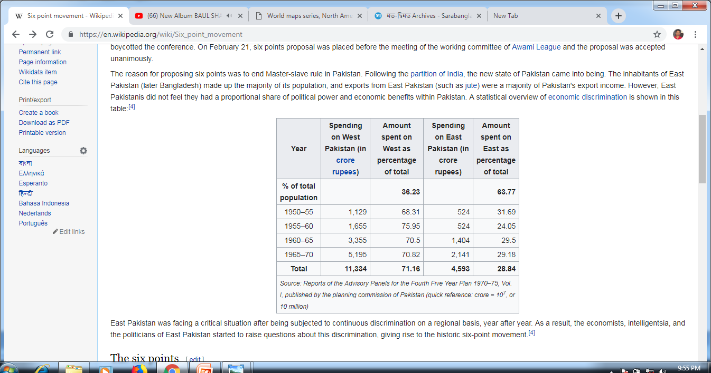

Slide 8
Military Perspective
Pakistan Army
Pakistan Navy
Pakistan Airforce
Head Offices of
West Pakistan

Slide 9
Military perspective (Con.)
Military was dominated by West Pakistanis
No safety measures were taken by government for the security of East Pakistan
It was Indian strategy that they didn’t attack East Pakistan in 1965 war
Para Military Force

Slide 10
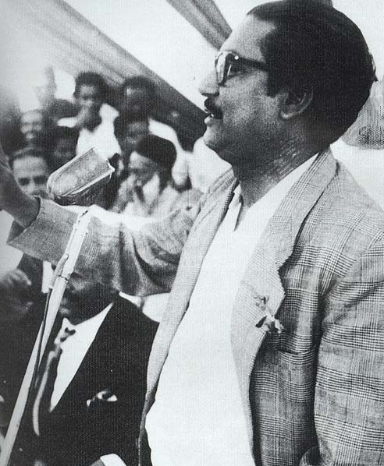
Declaration of six-point

Slide 11
Declaration of six-point
Opposition leaders in West Pakistan called for a national conference on February 6, 1966 to assess the trend of post-Taskent politics.
On February 4, Bangabandhu, along with some members of Awami League, reached Lahore to attend the conference.
The next day on February 5, he placed six points before the meeting of subject committee and urged to include the issue in the agenda of next day conference.
The proposal was rejected and Bangabandhu was identified as separatist.
On February 6, Bangabandhu boycotted the conference.
On February 21, six points proposal was placed before the meeting of the working committee of Awami League and the proposal was accepted unanimously.

Slide 12
The six points
Point-1
The Constitution should provide for a Federation of Pakistan in its true sense based on the Lahore Resolution, and the parliamentary form of government with supremacy of a Legislature directly elected on the basis of universal adult franchise.
Point-2
The federal government should deal with only two subjects: Defence and Foreign Affairs, and all other residual subjects should be vested in the federating states.
Point-3
Two separate, but freely convertible currencies for two wings should be introduced; or if this is not feasible, there should be one currency for the whole country, but effective constitutional provisions should be introduced to stop the flight of capital from East to West Pakistan. Furthermore, a separate Banking Reserve should be established and separate fiscal and monetary policy be adopted for East Pakistan.

Slide 13
The six points
Point-4
The power of taxation and revenue collection should be vested in the federating units and the federal centre would have no such power. The federation would be entitled to a share in the state taxes to meet its expenditures.
Point-5
There should be two separate accounts for the foreign exchange earnings of the two wings; the foreign exchange requirements of the federal government should be met by the two wings equally or in a ratio to be fixed; indigenous products should move free of duty between the two wings, and the constitution should empower the units to establish trade links with foreign countries
Point-6
East Pakistan should have a separate military or paramilitary force, and Navy headquarters should be in East Pakistan.

Slide 14
Reactions
West Pakistan Based Political Parties
Muslim Leage
Jamaat-E-Islami
Nizam-E-Islami
Dr. Rounaq Jahan succinctly summarised the hostile reactions of other political parties to the six-point formula: "The six-point demand not only split the Awami League but also made it difficult for the East Pakistan wing to form an alliance with any other West Pakistan-based party. The CML (Council Muslim League) decried the six points as a demand for confederation, not federation; the Jama'at-i-Islami branded it as a separatist design; the Nizam-i-Islam rejected it as a unilateral, dictatorial move on Mujib's part;
Pakistan People’s Party- ‘the six point formula was meant to strike at the roots of our nationhood. Initially it would have created two Pakistan, and later might well have brought five independent states into being’

Slide 15
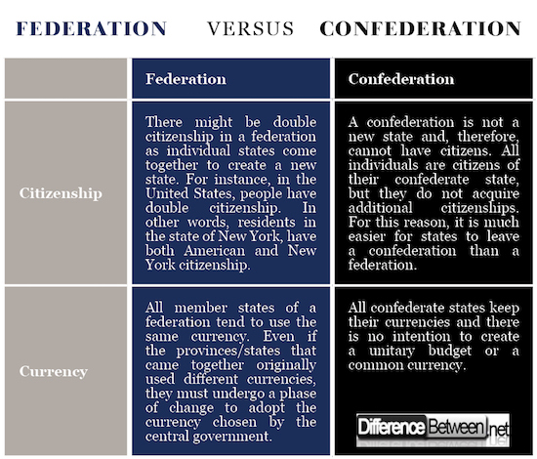

Slide 16
Reactions
East Pakistan Based Political Parties
NAP
Bhasani (China Policy)
Communist
and the NAP (National Awami Party) dismissed it on the grounds that it was parochial and did not include any measures to free East Pakistan from imperialists agents.
Awami League- A section of AL leaders also criticized six points and this section (most of them) belongs to West Pakistan. Nawabzada Nasrullah Khan left AL and formed Pakistan Democratic Movement. Region based politics started among Al as most of Eastee suported six points and westee oposed that. A small section of Estee joined with him under the leadership of Abdus Salam Khan. Mawlana Abdur Rashid Tarkbagish left the meeting opposing six points.
Six Points were placed to draw the attention of imperialist powers and Bhasani postulated that it was incomplete in economic sense. Some of NAP leaders marked six points as the plan of CIA. NAP presented 14 points as the response to six points.

Slide 17
Post six-point Development
On favor of six-point
On against of six-point
Sheikh Mujibur Rahman- Gave speech in several public gatherings and postulated it as ‘The charter of emancipation’
Day by day, Six points were gaining popularity among the people.
As a result, countrywide ‘hartal’ was announced on 7th June, 1966
The people of East Pakistan showed their massive support to the six pints
As a reaction to 7th june, on 8th june the member of opposition parties walked out from both house
People got infuriated with these decisions and formed huge public perception.
President Ayub Khan- As six points were getting popularity, He travelled East Pakistan in 1966 and gave speech in several public gatherings by marking him/it as conspirator, anti-state and the deed to separate Pakistan
Pakistani government tended to suppress the movement by means of imprisonment (Bangabandhu and his activists were arrested)
Law enforcing forces fired on the processions brought out by AL supporters on 7th June, several activists were died and many of them were wounded
From 13th june, imprisonment again started
15 th june, Taffazel HMM was arrested and on very next day Ittefaq, Dhaka Times and New Nation were banned.
On next Year, Rabindra Sangeett and Pahela Baishakh celebration was also banned by government
Bengali in arabic script
Agartala Conspiracy Litigation

Slide 18
IMPACT of six-point
1. ALL ROUND MOVEMENT
The imprisonment of Sheikh Mujibur Rahman and other top Awami Leaguers in 1966 could not diminish the mass support for the six-point demand, even though the intensity of the movement could be suppressed. The policy of suppression of all forms of political freedoms and dissenting voices had miserably failed to halt the march of the long-term effects and future implications of the six-point movement. In fact, the many forms of governmental repression and the use of police violence against the organisers and participants of the six-point movement had motivated the general population of the then East Pakistan to render their full support for the six-point formula.

Slide 19
2. SUBSEQUENT POLITICAL DEVELOPMENT
The six-point movement had also far reaching effects on the subsequent political developments in the then Pakistan. As noted by Dr. M. Rashiduzzaman: "The entire weight of the party (the Awami League) was thrown in favour of the anti-Ayub movement, which spread throughout the country in the early months of 1969, and it is likely that the Awami League will play an even more active role in the future (M. Rashiduzzaman, The Awami League in the Political Development of Pakistan, Asian Survey, Vol. 10, No. 7, July, 1970; pp. 574-587).“
The Victory of AL in 1970 election

Slide 20
3. Extended Version of 11-point Movement
An anti-Ayub mass movement in late 1968 and early 1969 led to the withdrawal of the so-called the case and unconditional release of Sheikh Mujibur Rahman.
About the impact of the six-point program on the 11-point charter of the 1969 student-mass movement, Dr. Rashiduzzaman observed: "For all practical purposes, the eleven-point student program was an expanded version of the Awami League's six- point demand for autonomy."

Slide 21
4. A Sense of Separation
The real strength of the Awami League is not its organisational skill but the growing popularity of its (Six-Point) program for regional autonomy with the 70 million Bengalis in East Pakistan. We have already noted that a popular movement started in East Pakistan following the announcement of Awami League's six-point program, and the changing pattern of Pakistan politics has eventually led to what is undeniably a separatist movement. Even the stringent repressive measures and centralised administration can't halt the process (of separatism). As the champion of the cause of regional autonomy, the future of the Awami League lies in its capacity to sustain and strengthen the movement

Slide 22
5. Sheikh Mujib as the Veritable Symbol of Bengali Nationalism
Dr. Talukder Maniruzzaman has noted the immediate impact of the governmental repressive measures during the six-point movement on Sheikh Mujibur Rahman's popularity in the following words: "As one might have expected, Sheikh Mujib's arrest in 1966 only served to enhance his popularity to the point where he became the veritable symbol of Bengali nationalism

Slide 23
6. Awami League as the Sole Party in East Pakistan
In 1964 when political activities on party basis were permitted, the Awami League (AL) emerged from its seclusion and reorganised itself, so that in 1966 it (AL) was able to give a concrete shape to its long-standing demand for regional autonomy in the form of "Six-Point Program," which subsequently was the harbinger of the emergence of Bangladesh as an independent and sovereign state in 1971

Slide 24
১.লাহোর প্রস্তাবের ভিত্তিতে সংবিধান রচনা করে পাকিস্তানকে একটি ফেডারেশনে পরিণত করতে হবে, যেখানে সংসদীয় পদ্ধতির সরকার থাকবে এবং প্রাপ্তবয়স্ক নাগরিকদের ভোটে নির্বাচিত আইন পরিষদ সার্বভৌম হবে;
২.ফেডারেল সরকারের হাতে থাকবে শুধু দুটি বিষয়, প্রতিরক্ষা ও বৈদেশিক সম্পর্ক, এবং অপর সব বিষয় ফেডারেশনে অন্তর্ভুক্ত রাজ্যসমূহের হাতে ন্যস্ত থাকবে;
৩.পূর্ব ও পশ্চিম পাকিস্তানের জন্য দুটি পৃথক অথচ সহজে বিনিময়যোগ্য মুদ্রা চালু করতে হবে। যদি তা সম্ভব না হয় তাহলে সমগ্র পাকিস্তানের জন্য ফেডারেল সরকারের নিয়ন্ত্রণাধীন একটিই মুদ্রাব্যবস্থা থাকবে, একটি ফেডারেল রিজার্ভ ব্যাঙ্ক ও দুটি আঞ্চলিক রিজার্ভ ব্যাঙ্ক থাকবে। তবে এক্ষেত্রে পূর্ব পাকিস্তান থেকে পুঁজি যাতে পশ্চিম পাকিস্তানে পাচার হতে না পারে তার ব্যবস্থা সম্বলিত সুনির্দিষ্ট বিধি সংবিধানে সন্নিবিষ্ট করতে হবে;
৪.দুই অঞ্চলের বৈদেশিক মুদ্রা আয়ের পৃথক হিসাব থাকবে এবং অর্জিত বৈদেশিক মুদ্রা রাজ্যের হাতে থাকবে। তবে ফেডারেল সরকারের জন্য প্রয়োজনীয় বৈদেশিক মুদ্রা দুই অঞ্চল থেকে সমানভাবে কিংবা উভয়ের স্বীকৃত অন্য কোনো হারে আদায় করা হবে;
৫.দুই অংশের মধ্যে দেশিয় পণ্য বিনিময়ে কোনো শুল্ক ধার্য করা হবে না এবং রাজ্যগুলো যাতে যেকোন বিদেশি রাষ্ট্রের সঙ্গে বাণিজ্যিক সম্পর্ক স্থাপন করতে পারে সংবিধানে তার বিধান রাখতে হবে।
৬.প্রতিরক্ষায় পূর্ব পাকিস্তানকে স্বাবলম্বী করার লক্ষ্যে আধা-সামরিক রক্ষীবাহিনী গঠন, পূর্ব পাকিস্তানে অস্ত্র কারখানা স্থাপন এবং কেন্দ্রীয় নৌবাহিনীর সদর দফতর পূর্ব পাকিস্তানে স্থাপন করতে হবে।
Was six-point a threat to Pakistan?????

